Slide 1
PREDICTION OF UNIVERSITY ADMISSIONS USING REGRESSION ANALYSIS
PRESENTED BY
TEAM 1

Slide 2
INTRODUCTION
Today, there are many students who travel to foreign countries to pursue higher education. It is necessary for the students to know what are their chances of getting an admit from such universities.
Universities manually check and count the total number of applicants who could get an admit into university. These methods are slow and certainly not very consistent for students and universities to get an actual result.
This method is also prone to human error and thus accounts for some inaccuracies. Since the frequency of students studying abroad has increased, there is a need to employ more efficient systems which handle the admission process accurately from both perspectives.
Our goal is to apply machine learning on the Admission Data using Regression Analysis.

Slide 3

PROBLEM STATEMENT
Now a days many students are facing problems regarding correct prediction of their chance of admit in the universities and they don’t have any knowledge on what input plays a major role in getting their admission in the university.

Slide 4
EXISTING SOLUTION
Currently the students are approaching consultancy agencies for getting admission into the university.
Some of the consultancies may misguide the students in prediction of university for their secured scores.

Slide 5
PROPOSED SOLUTION
Machine Learning algorithms can be implemented to analyze data and make predictions that are more accurate than the traditional methods.
Analyzing statistical data takes large time manually, machine learning algorithms are faster and gives much efficient solutions.
Here ,we developed different models using regression analysis which helps the students in predicting their chance of admit in their desired universities.

Slide 6
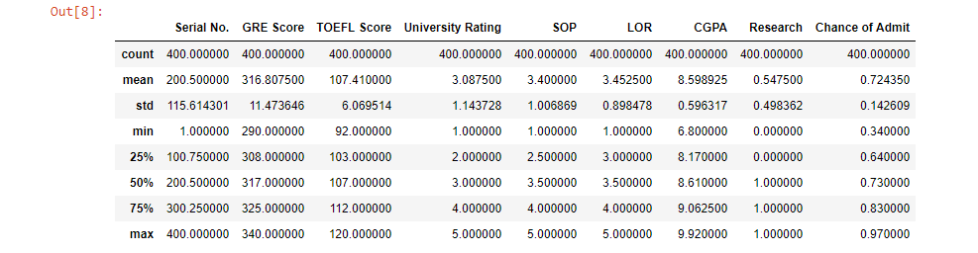
DESCRIPTIVE ANALYSIS

Slide 7
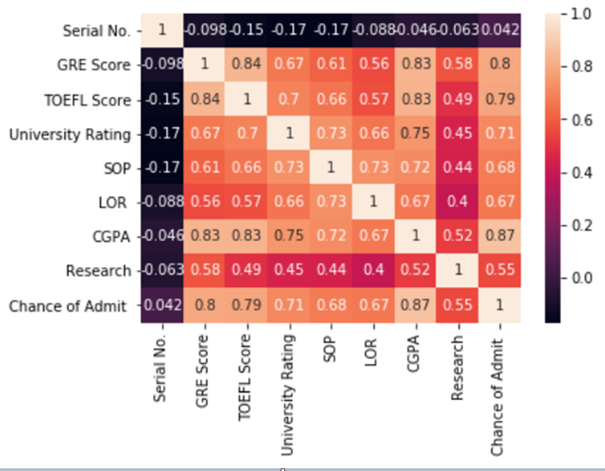
DATA INTERPRETATION
From the figure , we can say that as the colours of GRE Score , TOEFL Score, CGPA with Chance of Admit are brighter which says that they have high correlation.
Next follows the University Rating, SOP,LOR which are little darker when compared to the above three features but are bright so we can say that there is a strong correlation with Chance of Admit.

Slide 8
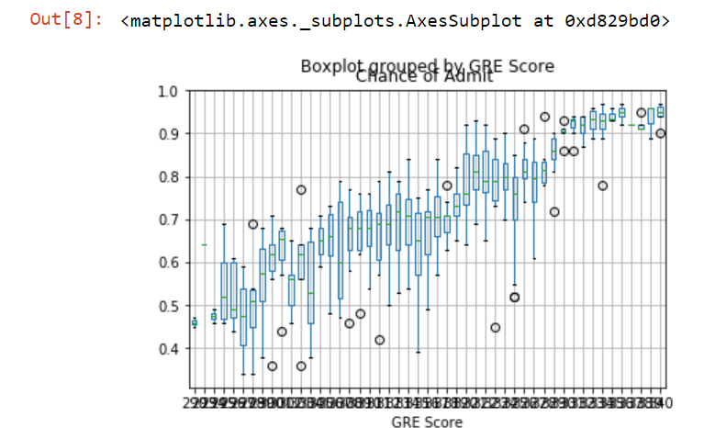
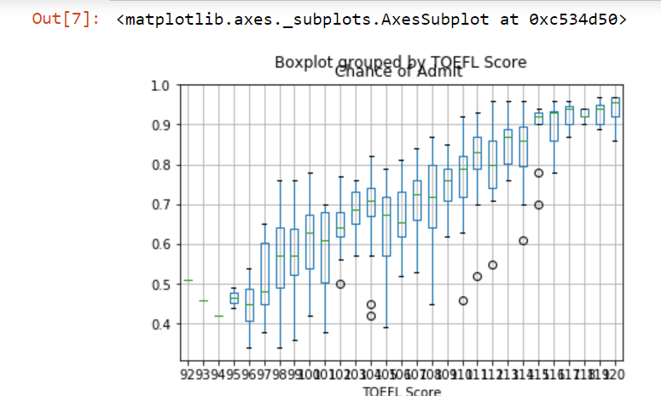
BOX PLOTS

Slide 9
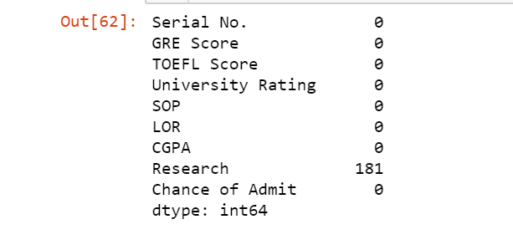
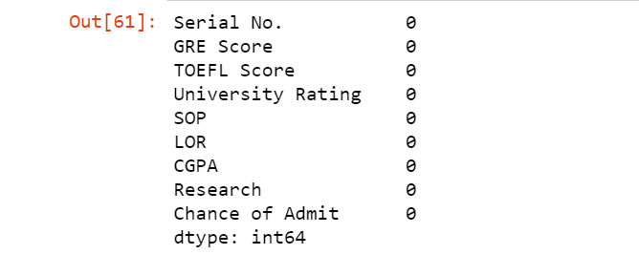
Missing Data Treatment
Zeroes in Data
NaN in Data

Slide 10
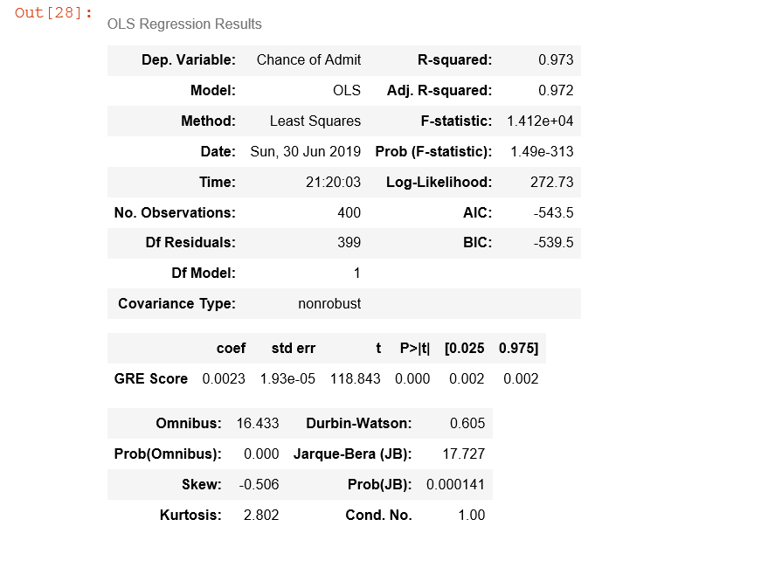
OLS Models and Accuracy for Linear Regression 1)OLS Model between GRE Score and Chance of Admit

Slide 11
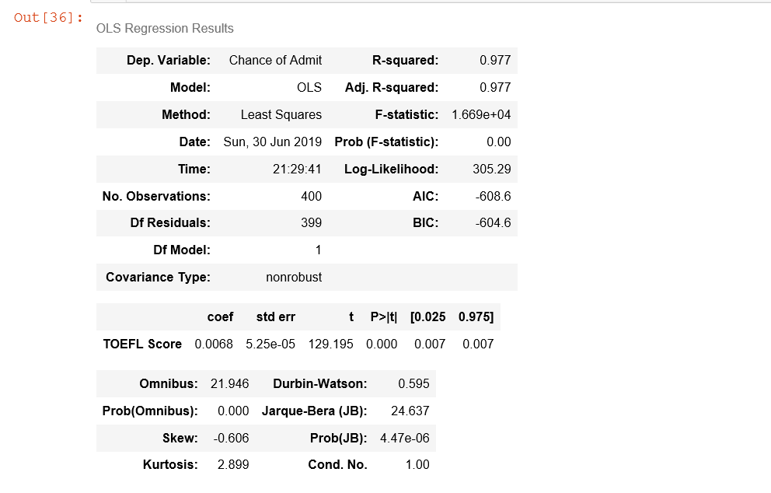
2)OLS Model between TOEFL Score and Chance of Admit

Slide 12
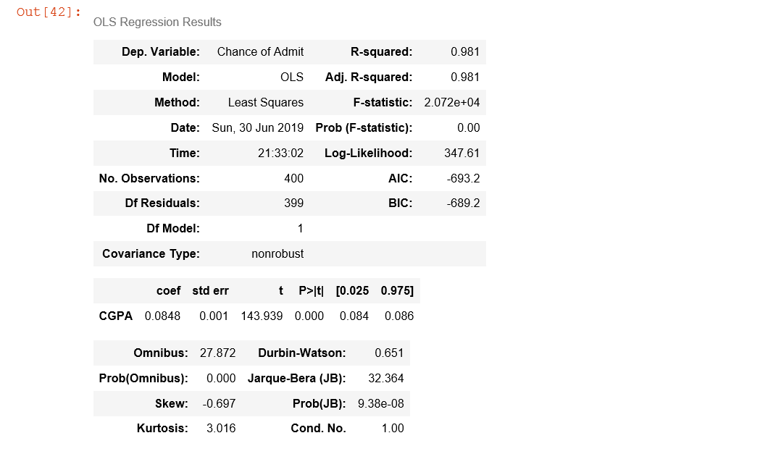
3)OLS Model between CGPA and Chance of Admit

Slide 13
RMSE and R2 SCORE: TRAINING DATA: TESTING DATA:
INPUT | OUPUT | RMSE | R2 SCORE
GRE | CHANCE OF ADMIT | 0.11670382 | 0.269074
TOFEL | CHANCE OF ADMIT | 0.10588406 | 0.3983216
CGPA | CHANCE OF ADMIT | 0.09568096 | 0.5086915
INPUT | OUTPUT | RMSE | R2 SCORE
GRE | CHANCE OF ADMIT | 0.1303908 | 0.2463980
TOEFL | CHANCE OF ADMIT | 0.12243583 | 0.33554620
CGPA | CHANCE OF ADMIT | 0.10958873 | 0.46767176

Slide 14
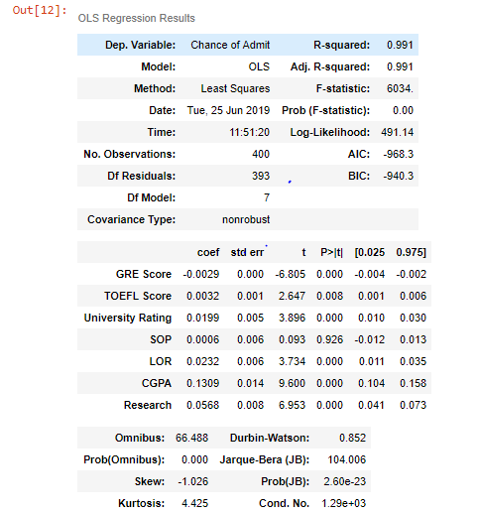
MULTIPLE REGRESSION

Slide 15
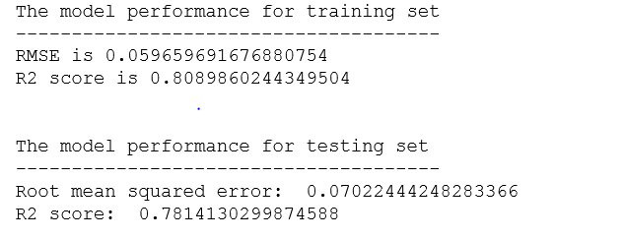
RMSE AND R2 SCORE FOR MULTIPLE REGRESSION

Slide 16
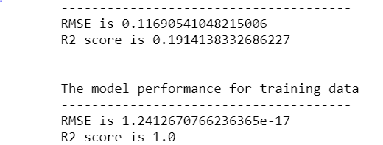
DECISION TREE REGRESSION Accuracy of the model: RMSE and R2 score:

Slide 17
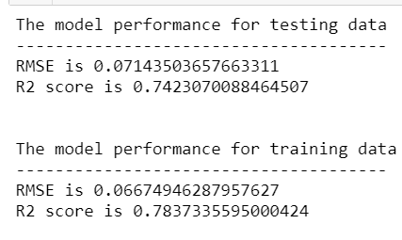
RANDOM FOREST REGRESSION Accuracy of the model for the train data: Accuracy for the test data: RMSE and R2 score:

Slide 18
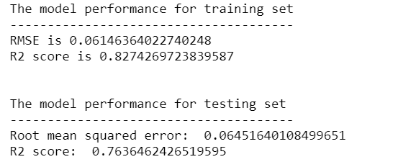
Neural Networks with REGRESSION RMSE and R2 score:

Slide 19

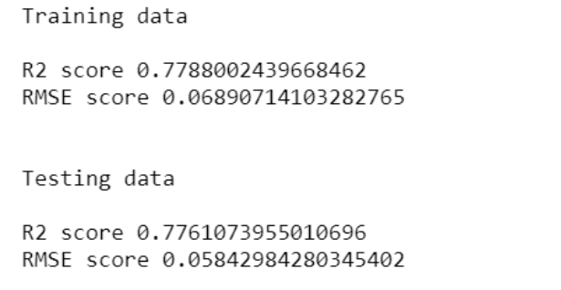
SUPPORT VECTOR REGRESSION Accuracy of the model for the train and test data: RMSE and R2 score:

Slide 20
CONCLUSION
The main objective of this research was to develop a prototype of the system that can be used by the students aspiring to pursue their education. Multiple machine learning algorithms like Linear Regression, Multiple Linear Regression, Decision Tree Regression, Support Vector Regression etc were developed and used for this research.
The overall objective of the research was achieved successfully as the system allow the students to save the extra amount of time and money that they would spend on education consultants and application fees for the universities where they have fewer chances of securing admission. Also, it will help the students to make better and faster decision regarding application to the universities.

Slide 21
CONCLUSION
MODEL | RMSE |  | R2 SCORE
 | Training | Testing | Training | Testing
Multiple regression | 0.059696 | 0.070224 | 0.80898 | 0.781413
Decision tree Regression | 1.24126 | 0.116905 | 1.0 | 0.1914
Random forest Regression | 0.06677 | 0.07143 | 0.783733 | 0.74320
Support vector Regression | 0.068907 | 0.05842 | 0.778800 | 0.776107
Neural networks with regression | 0.061463 | 0.064516 | 0.827426 | 0.763646

Slide 22


